Slide 1
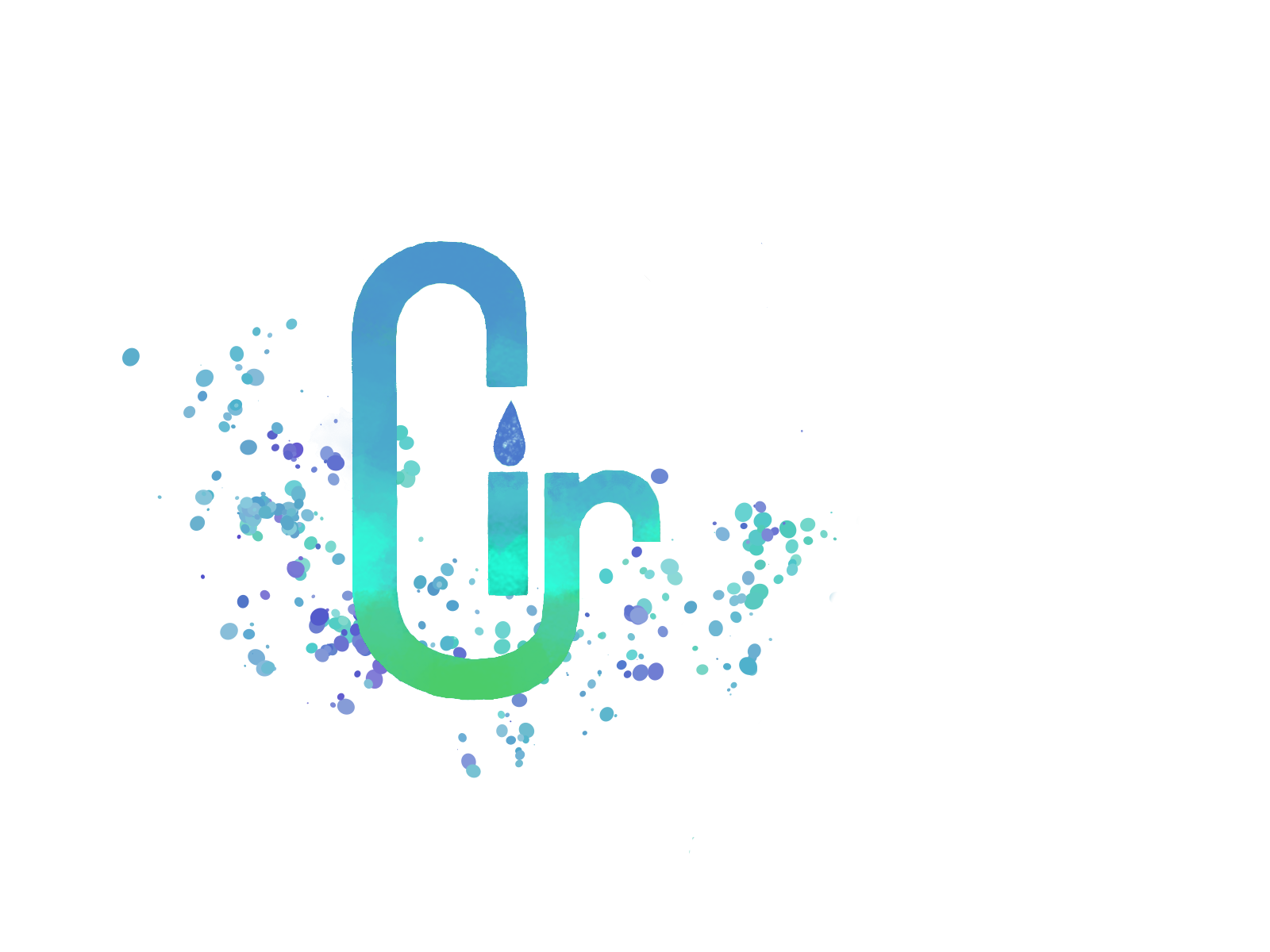
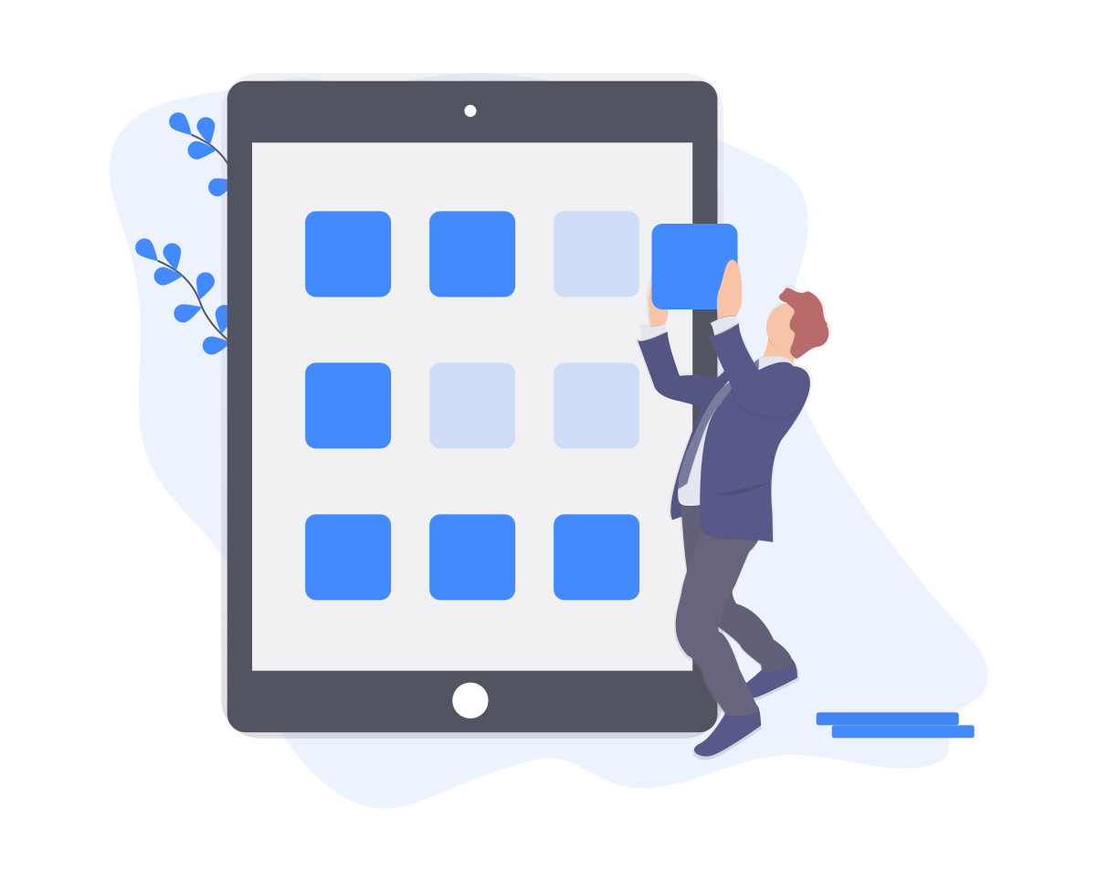
Lir Water Solutions
Our vision
Notes:
We are lucky
Water quality in the Netherlands is among the best in the entire world. Even still, contamination problems surface every now and again.
In other countries, problems are way more prevalent. In the US, water contamination with chemicals is a big deal, as can be seen by these headlines.
We want to fix this in three steps: Measure water contamination levels, notify users when water quality becomes problematic, and share this data with other users so they can avoid drinking contaminated water as well.
We will develop a measurement unit that will be attached in between your water access point and your water tap. Accompanying this, we will develop an app that will provide insight into the current water quality levels and inform you when water quality reaches critical levels.
This way, water drinkers all over the world can rest assured that their water quality levels are up to standards. Just like in the Netherlands.
Thank you!

Slide 2
Do not take clean water for granted
Januari 20, 2020 - NRC:
“Lead in drinking water at Amsterdam daycares”
Januari 22, 2020 - the Guardian:
“US drinking water contamination with ‘forever chemicals’ far worse than scientists thought”
May 7, 2019 - CBS News:
“43 states expose millions to dangerous chemical in drinking water”

Slide 3
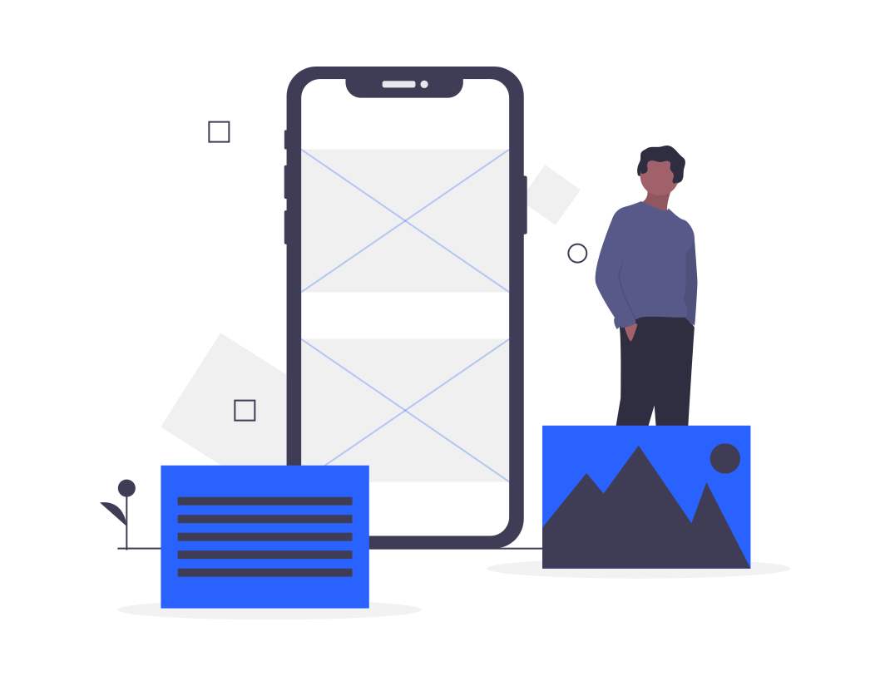
Our process is easy
Measure
Notify
Share
1
2
3

Slide 4
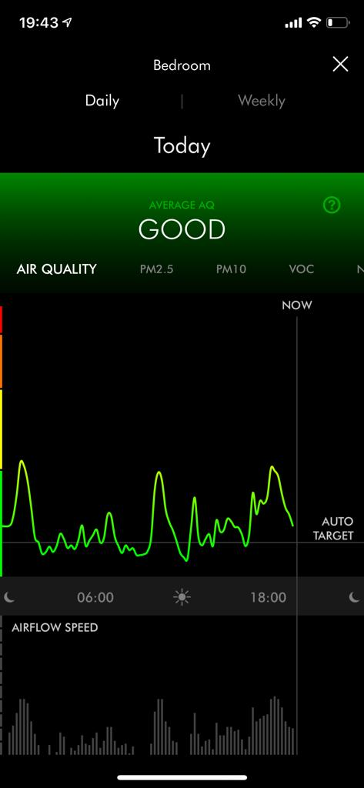
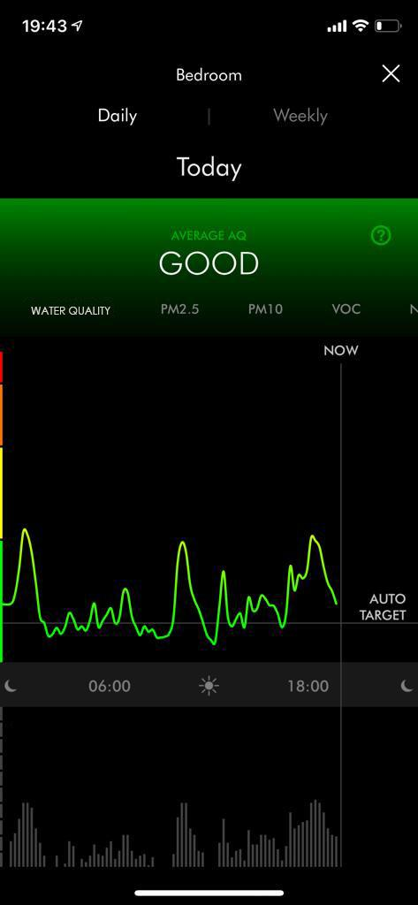
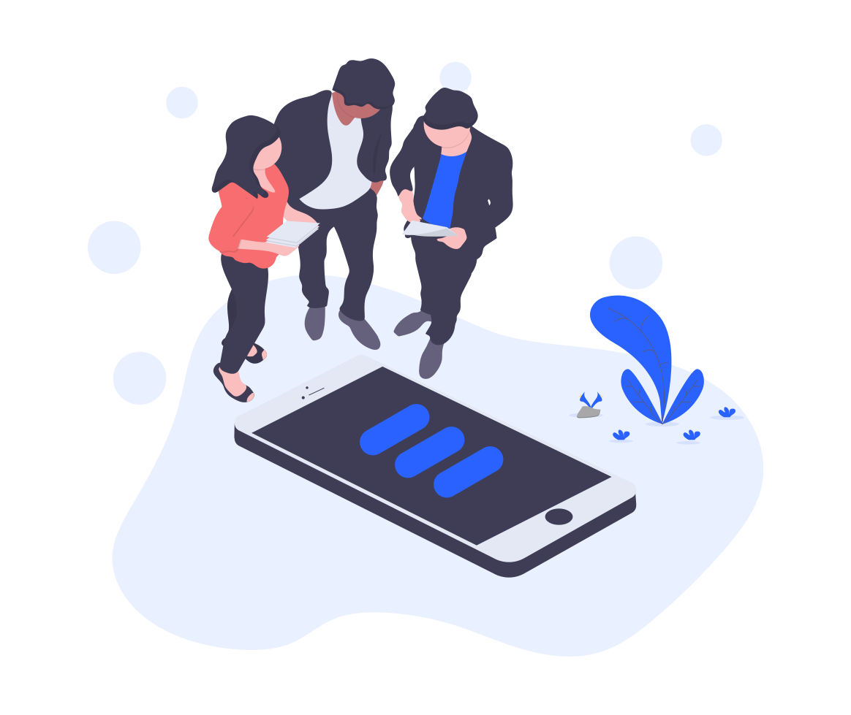
The App
Place your screenshot here
Initial app concept

Slide 5
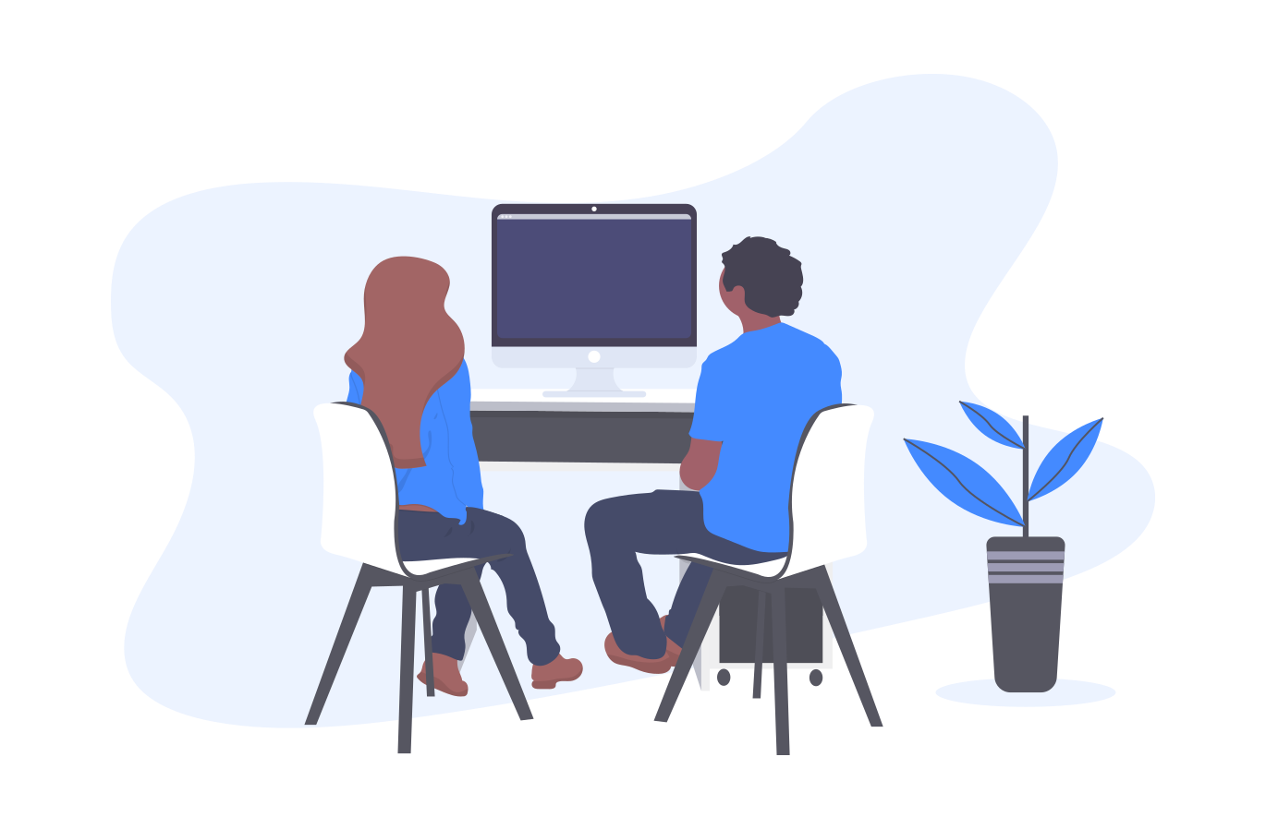
Thanks!
Any questions?

